Slide 1
Final Presentation
Team CHHAR-coal G2T6
Lim Wai Liang Aloysius
Chen Huiyan
Haseena Banu Binte Ghulam Mohamed
Seah Chen Xun Regan
Lim Wei Lin Cheryl

Slide 2
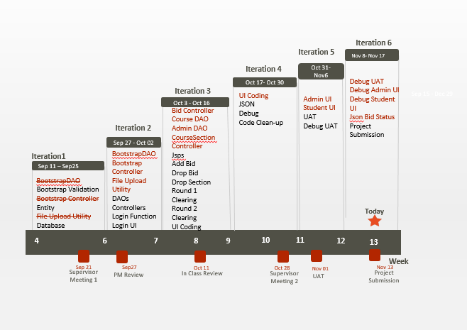
Schedule

Slide 3
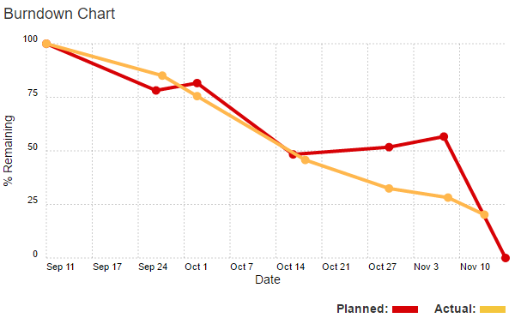
Schedule

Slide 4

Schedule
Functions
No functions dropped
Bid Status Web Service function added
Frameworks
No frameworks used
Similar implementation to MVC Model

Slide 5
Schedule
External Libraries Used
MySQL JDBC Driver
opencsv-3.8.jar
commons-lang3-3.4.jar
uploadbean.jar
cos.jar
gson-2.3.jar
is203-jwt-v2.jar
json-smart-1.2.jar
nimbus-jose-jwt-2.26.1.jar
Database Access
CSV Reader
File upload
Web Service Requirements

Slide 6
Breakdown of programming tasks

Slide 7
Breakdown of Work Iteration 1
Category | Main Function | AL | RS | HY | H | CL
Bootstrap | BootstrapDAO | X |  | X | X | X
 | Bootstrap Controller |  |  | X | X
Bootstrap Validation | Student Validation |  |  | X |  | X
 | Course Validation |  | X | X
 | Pre-req Validation | X |  |  |  | X
 | Section Validation |  |  | X | X
 | Course-Complete Validation |  | X | X
 | Bid Validation | X |  |  | X
 | Common Validation |  |  | X | X
Entity | Entity | X | X | X |  | X
Utility | File Upload Utility | X |  |  |  | X
Database | Database | X |  |  |  | X
Debug | Debug Session |  |  | X | X

Slide 8
Breakdown of Work Iteration 2
Category | Main Function | AL | RS | HY | H | CL
Debug | Debug Bootstrap Function |  | X |  | X
Data Access Objects | BidDAO |  |  | X | X
 | CourseDAO |  |  | X | X
 | StudentDAO |  | X |  |  | X
 | SectionDAO |  | X |  | X
Controller | Bootstrap Controller |  |  | X |  | X
 | Bid Controller |  |  | X | X
 | Student Controller |  | X |  |  | X
 | CourseSection Controller |  | X |  | X
Login | Login Function | X |  |  |  | X
 | Login UI | X |  |  | X

Slide 9
Breakdown of Work Iteration 3
Category | Main Function | AL | RS | HY | H | CL
Student | Homepage | X |  | X
 | Search Sections |  | X | X
 | Add Bid Function |  | X |  | X
 | Drop Bid Function |  | X |  |  | X
 | Drop Section Function | X |  |  |  | X
 | Update Bid Function | X | X
 | View Course Complete | X |  | X
Debug | Debug Student Function |  |  | X | X
Admin | Homepage |  | X | X
Controllers | CourseSection Controller |  | X |  | X
 | Round Controller |  | X | X
 | CourseSectionController |  | X |  |  | X
DAO | CourseComplete DAO |  | X |  | X
 | Round DAO |  | X | X
Debug | Debug deployment bugs | X |  |  |  | X
R1 Clearing | Bid DAO - Clearing Price & Update Status |  |  |  | X | X
 | Round Controller - Process Refunds |  | X | X
 | Round Controller - Process Round 1 Logic | X |  |  |  | X
R2 Clearing | Bid DAO - Compute Min Bid | X |  |  |  | X
 | Display bids live results | X | X
UI | UI for new implementations | X |  |  |  | X
Debug | Debug Session | X |  |  |  | X

Slide 10

Breakdown of Work Iteration 4
Category | Main Function | AL | RS | HY | H | CL
Debug | Debug deployment bugs |  | X |  |  | X
JSON | JSON Authenticate |  | X |  |  | X
 | JSON Bootstrap | X | X
 | JSON Update Bid |  |  |  | X | X
 | JSON Start Round |  | X | X
 | JSON Stop Round |  |  | X | X
 | JSON Delete Bid |  | X |  | X
 | JSON Drop Section |  | X |  | X
 | JSON Dump Table | X |  |  |  | X
 | JSON Dump User |  | X | X
 | JSON Dump Bid | X |  |  |  | X
 | JSON Dump Section | X |  |  |  | X
 | JSON Common Validation | X |  |  | X
Debug | JSON Debug | X |  |  | X
Debug | Debug deployment bugs | X |  | X
UI | UI Coding | X |  | X
Debug | Debug Session | X |  |  |  | X
Format | Code clean up | X |  |  |  | X

Slide 11
Breakdown of Work
ITERATION 5
Category | Main Function | AL | RS | HY | H | CL
Debug | Debug UAT bugs |  |  | X | X
UI | Admin UI |  | X |  | X
 | Student UI |  |  | X | X
Debug | Debug UAT JSON bugs |  | X | X
ITERATION 6
Category | Main Function | AL | RS | HY | H | CL
Debug | Debug Regression Test 1 |  | X | X
JSON | JSON Bid Status | X |  | X
Debug | Debug JSON Bid Status |  | X |  |  | X
Debug | Debug UAT |  | X | X
Debug | Debug UI |  | X |  | X
Debug | Debug Regression Test 2 |  | X |  | X
Debug | Debug deployment bugs |  |  |  | X | X

Slide 12
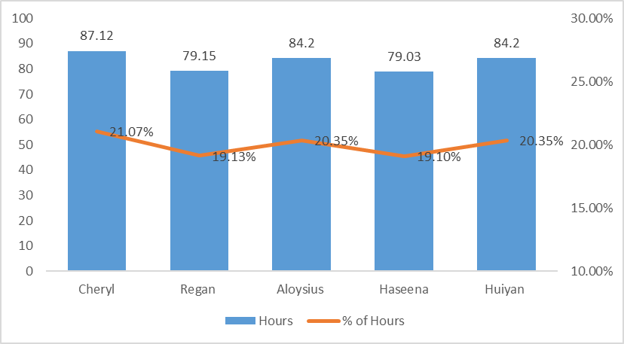
Programming Hours by Member

Slide 13
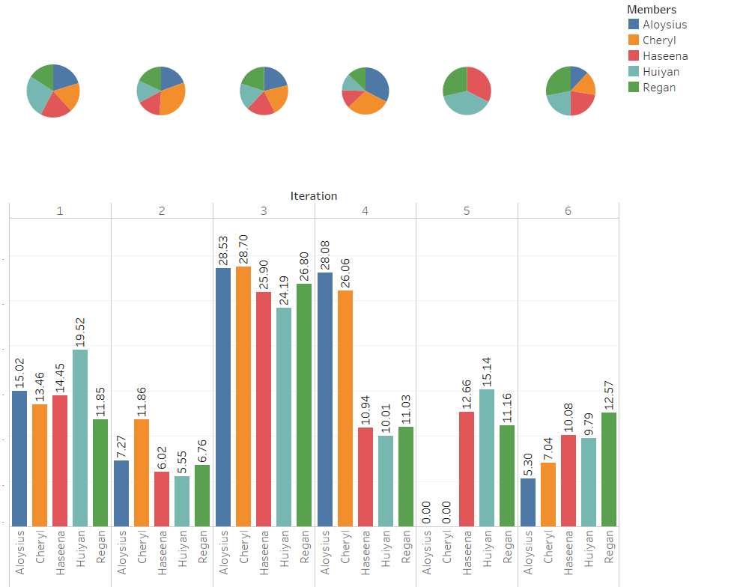
Programming Hours by iteration

Slide 14
Breakdown of NON-programming tasks

Slide 15
Breakdown of Work Iteration 1
Main Function | AL | RS | HY | H | CL
Knowledge Sharing Session | X | X | X | X | X
Review Bootstrap Function | X | X | X | X | X
Design Class Diagram | X | X | X | X | X
Design ER Diagram | X | X | X | X | X
Design Sequence Diagram | X | X | X | X | X
Design Logical Diagram | X | X | X | X | X
Design Use Case | X | X | X | X | X
Supervisor Meeting | X | X | X | X | X
Function Review | X | X | X | X | X
Test Code | X | X | X | X | X
Validation Test Case |  | X

Slide 16
Breakdown of Work Iteration 2
Main Function | AL | RS | HY | H | CL
Finalise Project Documents | X | X | X | X | X
Function Review | X | X | X | X | X
Knowledge Sharing Session | X | X |  |  | X
Review Login Function Logic and Flow | X | X | X | X | X
Test Bootstrap Function | X | X | X | X | X

Slide 17
Breakdown of Work Iteration 3
Main Function | AL | RS | HY | H | CL
Add Bid Test Case |  |  |  | X
Drop Bid Test Case |  |  |  | X
Drop Section Test Case |  |  |  | X
Login Test Case |  |  |  | X
Search Section Test Cse |  |  |  | X
Update Bid Test Case |  |  |  | X
Test Bootstrap Function |  | X |  | X
Supervisor Consultation | X | X | X | X | X
Deployment to AWS | X | X
Group Meeting | X | X | X | X | X
Function Review |  |  | X |  | X
In class Review | X | X | X | X | X
Round 1 Test Case |  |  |  | X
Round 2 Test Case |  | X |  |  | X
Admin Function Review | X | X | X | X | X
Run Add Bid Test Case |  |  | X |  | X
Buffer Day | X | X | X | X | X
Run Drop Bid, Drop Section, Search Bid TestCases |  |  | X |  | X

Slide 18
Breakdown of Work Iteration 4
Main Function | AL | RS | HY | H | CL
Knowledge Sharing Session on JSON |  | X
Test Case Json |  |  | X
Test Function on AWS | X | X
Supervisor Meeting 2 |  | X
Test Code Json |  |  | X | X
Debug Buffer Time | X | X | X | X | X
Min bid amount logic Test Case |  |  |  | X
Json Function Review |  |  | X |  | X

Slide 19
Breakdown of Work Iteration 5
Main Function | AL | RS | HY | H | CL
UAT AWS Deployment |  |  | X
User Acceptance Test |  |  | X
Regress Testing Session 1 |  | X
Run Json test Case |  |  |  | X
UI Test |  |  |  |  | X

Slide 20
Breakdown of Work Iteration 6
Main Function | AL | RS | HY | H | CL
Create Bid Status Test Case |  |  |  | X
Test JsonBidStatus |  |  | X
Regression Testing Session 2 | x
Deploy and Test AWS |  | X
Update Documentation |  |  |  |  | X
Project Submission |  |  |  |  | X
Final Presentation |  |  |  |  | X
Function Review |  |  |  |  | X

Slide 21
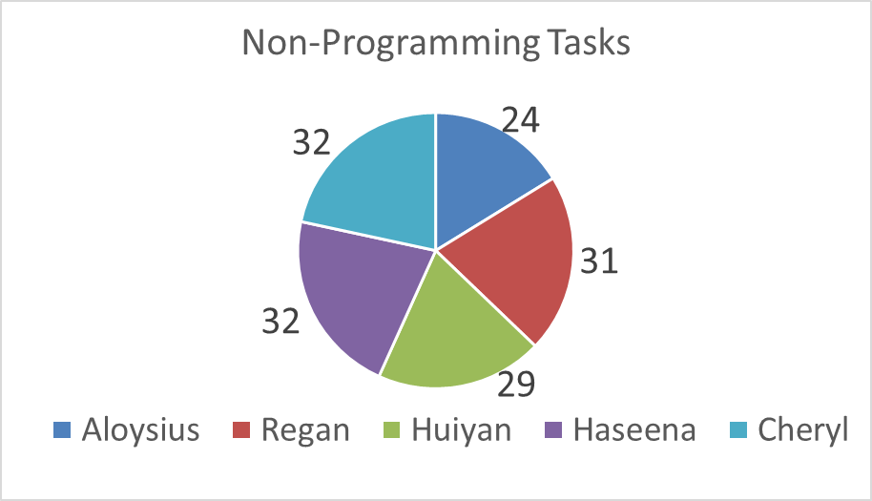
Non-Programming task distribution

Slide 22
Fair Task allocation
Programming
Everyone got to try coding various class types i.e. DAO, Servlets, UI, Controller, Debug, JSON
Everyone got to handle a logic heavy task i.e. Clear round, Add bid, Drop bid, Drop Section
Non-programming
Everyone PM-ed a Milestone
Took turns to do minutes, testing, diagraming

Slide 23
Problems Faced With Scheduling
Too detailed
Scheduled tasks too specifically
Split tasks into files rather by functionality
A lot of admin/overhead from having high task numbers
Corrections made
Change scheduling by functionality
Slightly more macro view

Slide 24
Metrics

Slide 25
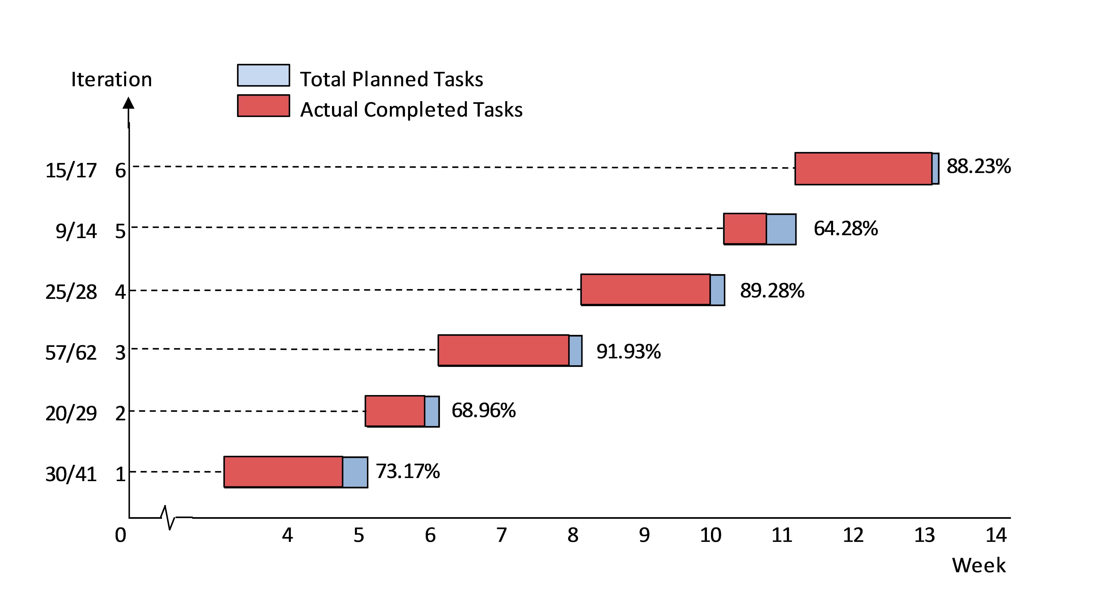

Metrics – Task Metrics

Slide 26
Metrics – Task Metrics
Using the metric
Re-estimate future iterations
Deduct from buffer days
Ensure that current tasks are being done
Awareness of our overall project progress

Slide 27
Metrics – Task Metrics
Example:

Slide 28
Metrics – Bug Metrics
Iteration | 1 | 2 | 3 | 4 | 5 | 6
Bug Value | 29 | 5 | 187 | 54 | 144 | 25

Slide 29
Metrics – Bug Metrics
Using the metric
If (Bug value >= 10 ){ stopCurrentDevelopment(); setupDebuggingSession(); }
Bug metrics format: - When was the bug found? - Who found it? - Where was it found? - Is it resolved?

Slide 30
Metrics – Bug Metrics
Iteration 3 Bugs
Date Found | File | Details | Impact Level | Bug Value | Test Case | Found by
16/10/16 | AddBid Servlet | Able to add a bid during inactive round | High | 5 | AddBid TestCase 15 | Cheryl Huiyan
16/10/16 | Search Section | Was not able to add decimal bid amount | high | 5 | AddBid TestCase 16 | Cheryl Huiyan
16/10/16 | Bid Controller | Bid section limit doesn’t include enrolled sections | high | 5 | AddBid TestCase 17 | Cheryl Huiyan
16/10/16 | Bid Controller | Able to bid fro section already enrolled in | High | 5 | AddBid TestCase 18 | Cheryl Huiyan
16/10/16 | Search Section | Shows a blank page when searching for section under course that doesn't contain sections | High | 5 | Search TestCase 5 | Cheryl Huiyan
16/10/16 | Student Home | The second and the following successful bids are out of the enrolment table | Low | 1 | Round1 TestCase3 | Aloysius Huiyan
16/10/16 | BidDAO | 2 bids at the clearing price can be bidded successfully with only 1 available slot | High | 5 | Round1 TestCase5 | Aloysius Huiyan
Bugs found during testing >10 added debugging session to schedule
Notes:
These were our iteration 3 bugs, iteration ended on 18 october

Slide 31
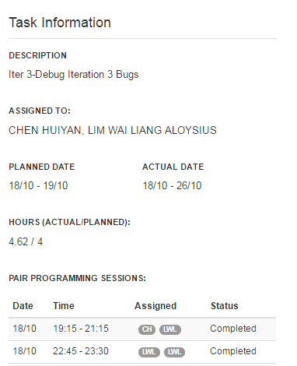
Metrics – Bug Metrics
As bugs were found at the end of Iteration 3
Shift debugging tasks to Iteration 4
Ensure that debugging is done before starting to work on iteration 4 functionalities
Notes:
Iteration 3: 3/10 – 16/10
Iteration 4: 17/10 – 30/10

Slide 32
Metrics – Bug Metrics
Challenges
Person who found the bug is not the one who fixed it. Person debugging has to replicate, understand and solve the bug.
Being disciplined about resolving the bugs before continuing with function coding
Notes:
Iteration 3: 3/10 – 16/10
Iteration 4: 17/10 – 30/10

Slide 33
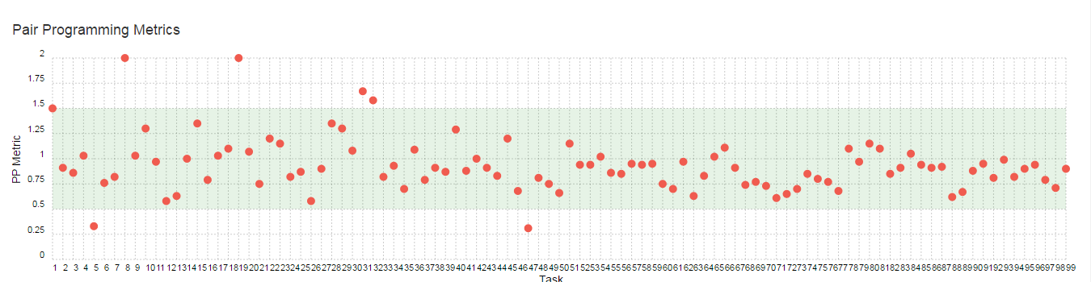
Metrics – Pair programming Metrics
Student Controller
Login UI
Create Bid Entity
Search Section Servlet
Challenges
Estimating hours to allocate to tasks (Overestimated servlet coding hours)
Re-estimated and adjusted the hours for the iteration and subsequent ones

Slide 34
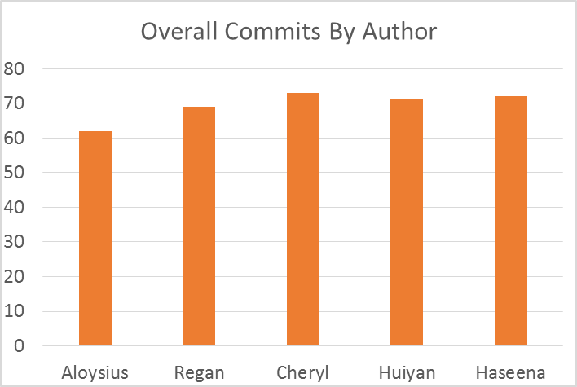
Use of GIT

Slide 35
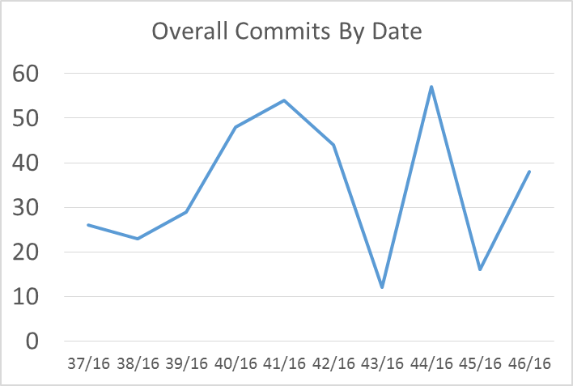
Use of GIT
UAT Week
Lab Test Week

Slide 36
Mistakes Made
Forgot to stop pplog task and left it running
Pushed code outside session (Reason: adding in checking of corner case)
Accidentally stopped iteration
Deleted file in app folder outside of session (Reason: cleaning up folder directory)

Slide 37
takeaways
Lessons learnt
Managing the process is more important
Programming errors can be mitigated with a well planned process
Adapting to change and ambiguity
Project management is an iterative process
Importance of communication

Slide 38

Did you know?
Aloysius
Judo – yellow belt… beware!
Likes to eat Japanese food
Is like a grizzly bear
If he disappears under any circumstances, 90% of the time you’ll end up finding him chatting with a girl.

Slide 39
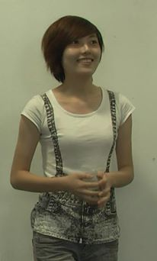
Did you know?
Huiyan
Bubbly Happy Pill
Is an explorer! (*cough* gets lost easily *cough*)
Make sure to hold her hand and keep her close when crossing roads! (Dangerous road crosser)

Slide 40

Did you know?
Haseena
Secretly Bad-Ass
She know how to skateboard!
Throws you 3rd Degree burns with a one-liner
Super duper meticulous DOCUMENTATION QUEEN

Slide 41

Did you know?
Regan
Your one-stop walking BLOOMBERG finance advisor
Resource King
Labs is almost his first home…
Walking mama-shop, go to him for SNACKS!

Slide 42
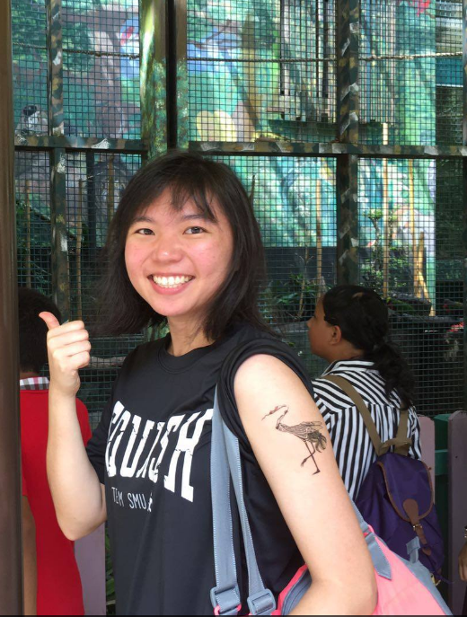
Did you know?
Cheryl
Her blood is filled with mashed potato and eggs.
If she doesn’t play squash, she becomes a dominatrix.
Once she starts laughing, she cannot stop. Really. CANNOT. STOP.
The fastest way into her heart is the directions to a duck rice stall and a cup of Starbucks. No questions asked.

Slide 43
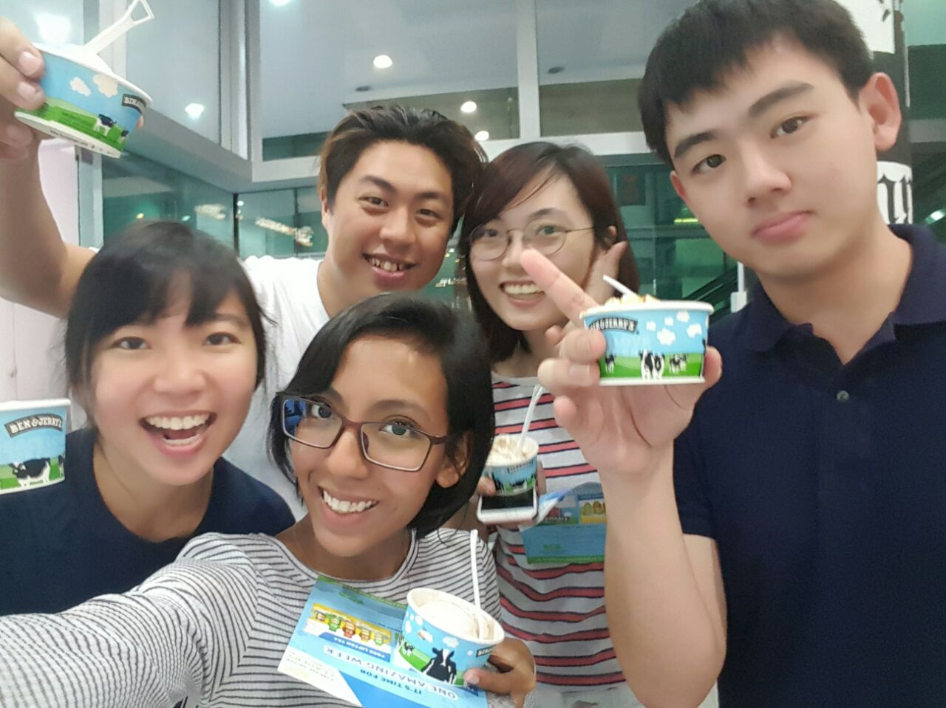
Thank you!

Slide 44
Iteration 5
Iteration 6
Nov 8- Nov 17
Iteration 4
Oct 31-Nov6
Oct 17- Oct 30
Debug UAT
Debug Admin UI
Debug Student UI
Json Bid Status
Project Submission
Iteration 3
UI Coding
JSON Debug
Code Clean-up
Sep 15 - Dec 29
Oct 3 - Oct 16
Admin UI
Student UI
UAT
Debug UAT
Iteration 2
Bid Controller
Course DAO
Admin DAO
CourseSection Controller
Jsps
Add Bid
Drop Bid
Drop Section
Round 1 Clearing
Round 2 Clearing
UI Coding
Sep 27 - Oct 02
Iteration1
BootstrapDAO
Bootstrap Controller
File Upload Utility
DAOs
Controllers
Login Function
Login UI
Sep 11 – Sep25
BootstrapDAO
Bootstrap Validation
Bootstrap Controller
Entity
File Upload Utility
Database
Today
Mar 31
Jun 30
Sep 30
2015
4 6
7
8 9
10 11
12
13
2017
Sep 21
Sep27
Oct 11
Week
Supervisor Meeting 1
PM Review
In Class Review
Oct 28
Nov 01
Nov 13
Supervisor Meeting 2
UAT
Project Submission

